Slide 1

File and Printer sharing in Windows NT Environment
NATIONAL INSTITUTE OF ELECTRONICS AND INFORMATION TECHNOLOGY
Birla Farms, Bada Phull, Ropar
NIELIT ‘O’-Level
IT Tools and Network basics

Slide 2
Pivot Tables, Data Validation and What-if analysis

Slide 3
Index
Pivot Tables
Introduction
Creating Pivot Table
Pivot Table Layout
Editing Pivot Table
Updating Pivot Table
Deleting Pivot Table
Data Validation
What-if analysis
Introduction
What-if analysis tools
Consolidate
Subtotals
Scenarios
Goal Seek

Slide 4
Pivot tables

Slide 5
Pivot Tables
Pivot Tables are one of the most powerful and useful tools in Calc. With this tool you can combine, compare, and analyzing large amounts of data easily. Using Pivot Tables, you can view different summaries of the source data.

Slide 6
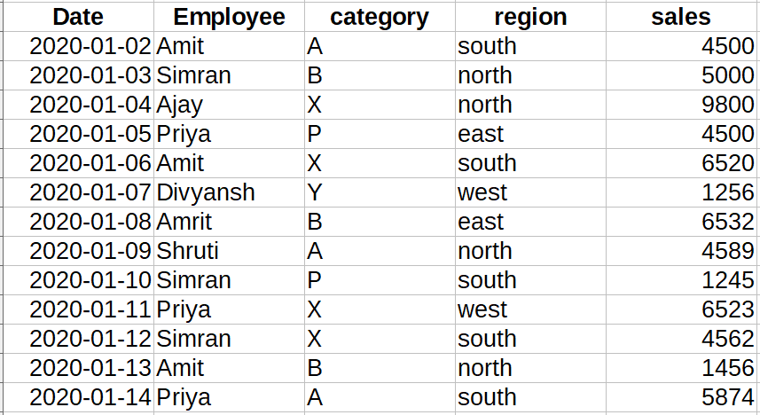
Pivot Tables
Why use Pivot Tables
To better understand pivot tables let's examine an example. The spreadsheet below records sales of employees in different region. To answer the question what is the amount sold by each salesperson it could be time consuming and difficult because each salesperson appears on multiple rows. We could use the Subtotal command to find the total for each salesperson, but we would still have a lot of data to work with.

Slide 7
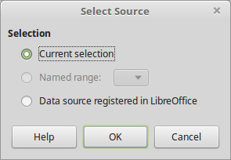
Creating Pivot Tables
Pivot table can created on data that have the table format which means no empty columns or rows and the first row contains the column names.
To create a Pivot Table:
Select only one cell from your data.
Choose the Insert ->Pivot Table command from the main menu or click the icon on the Standard toolbar.
Libre Calc automatically selects all the cells and opens the Select Source dialog. Click OK to continue

Slide 8
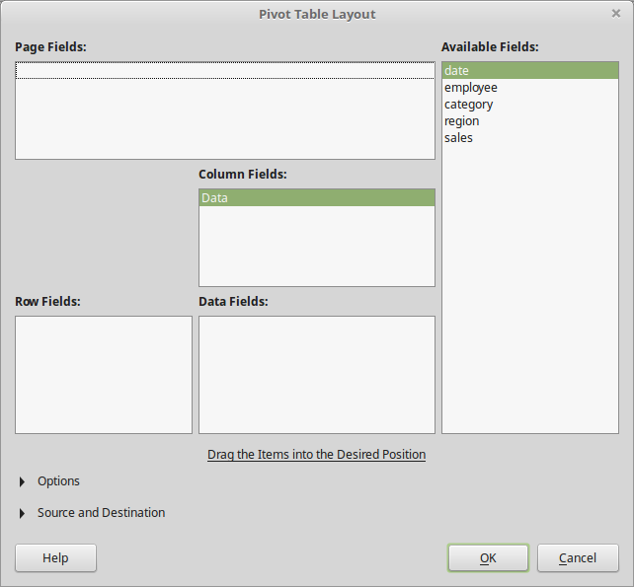
Creating Pivot Tables
In the Pivot Table Layout Dialog you set up the pivot table. In general you drag fields from the Available Fields pane to the other white areas.

Slide 9
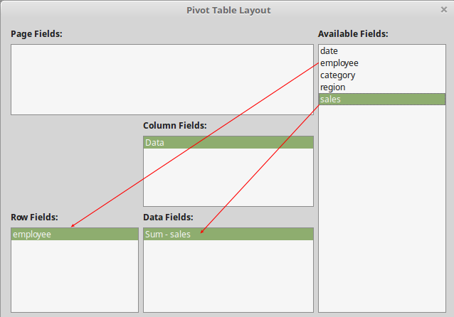
Creating Pivot Tables
Drag the employee field to the Row fields are and the sales field to the Data Fields area and click OK.

Slide 10
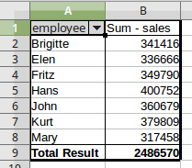
Creating Pivot Tables
The pivot table is created in a new sheet. Now we get a summary of the sum of sales for each employee.

Slide 11
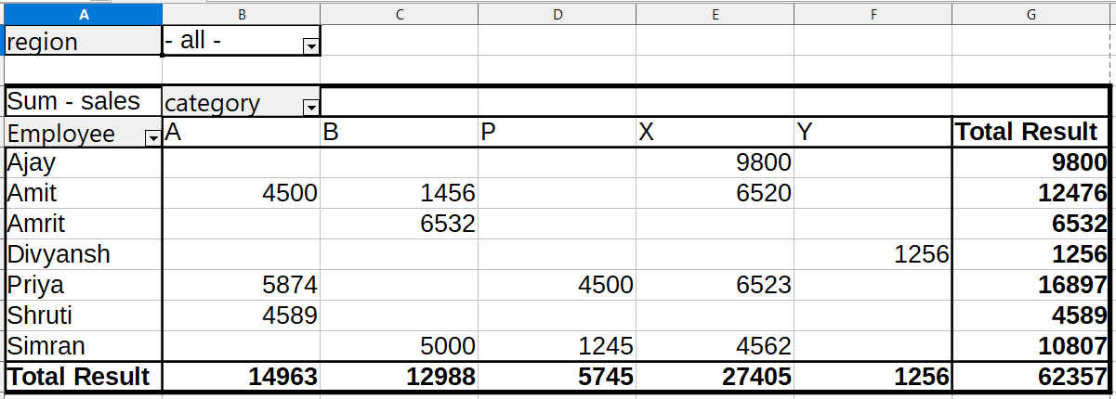
Pivot Table Layout
Pivot Table Layout
The layout of the pivot table is divided into 4 parts: Rows, Columns, Data and Page. If you understand the layout you will be able to create more complex pivot tables and extract important information from your data.
Page
Columns
Rows
Data

Slide 12
Pivot Table Layout
The Rows Area
When you drag a field into the Rows area of the pivot table, all the unique values in that field will be displayed in the first column of the pivot. The pivot table removes all the duplicates in the field (column of source data) and only displays the unique values. In the example we used the employee field for the Row area.
The Data Area
The Values area displays the data (values) that we want to summarize in our pivot table report. When you drag a field into the Values area, the pivot table will automatically sum or count the data in that field. If the data in the field contains numbers, then the sum will be calculated. If the data contains text or blanks, then the count will be calculated.

Slide 13
Pivot Table Layout
The Columns Area
The Columns area works just like the Rows area. It lists the unique values of a field in the pivot table. The only difference is that it lists the values across the top row of the pivot table. In the example above we used the category field in the Columns Area.
Page Area
Fields that are placed into the Page Fields area appear in the result above as a drop down list. The summary in your result takes only that part of your base data into account that you have selected. In the example above we used the region field in the Page Fields Area.

Slide 14

Editing a Pivot Table
Edit a pivot Table
The real value of Pivot Tables is that they can quickly pivot (or reorganize) your data, allowing you to examine them in multiple ways. Pivoting data can help you answer different questions and discover new trends and patterns. To edit a pivot table layout, right click anywhere inside the Pivot Table and select Edit Layout from the context menu.

Slide 15
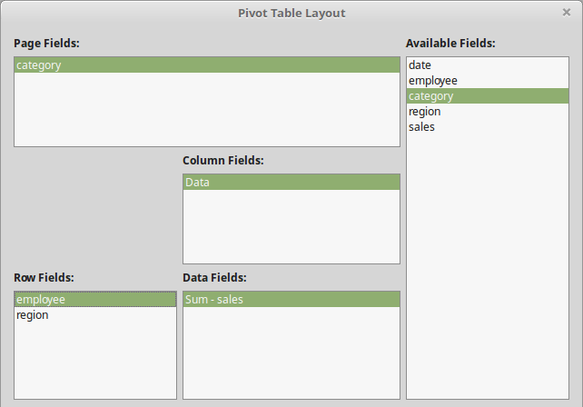
Editing a Pivot Table
The Pivot Table Layout dialog window opens and allows you to delete, add or reorder fields in the layout.

Slide 16

Updating a Pivot Table
Updating the Pivot Table
A Pivot Table will not update automatically if you change any of the data in your source sheet. To update, right click anywhere inside the Pivot Table and select Refresh from the context menu.

Slide 17
Updating a Pivot Table
Data Fields calculation
By default numerical fields that are placed in the Data area are summarized with the SUM function. For text fields the default calculation is the COUNT function. This is why it's important to make sure you don't mix data types for value fields. You can change the calculation of a Data field in the Pivot Table Layout window.

Slide 18
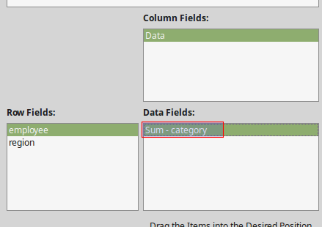
Updating a Pivot Table
To change the calculation double click on the field in the Data area.

Slide 19
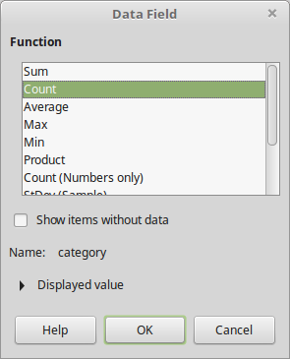
Updating a Pivot Table
In the Data Field pop up window select the function and click OK

Slide 20
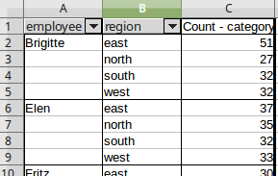
Updating a Pivot Table
The following pivot table example uses the COUNT function for the category field

Slide 21
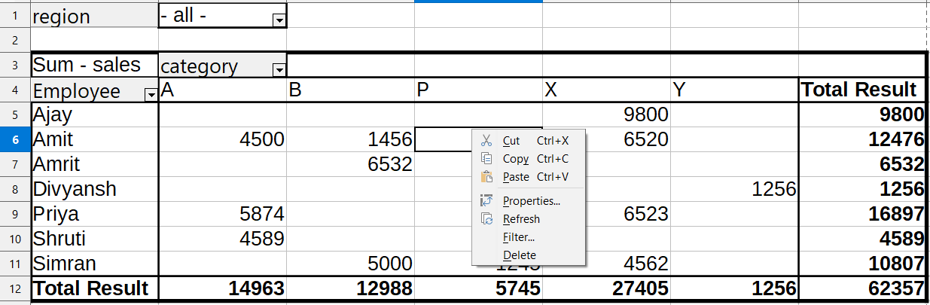
Deleting a Pivot Table
Delete a Pivot Table
To delete a pivot table, right click anywhere inside the Pivot Table and select Delete from the context menu.

Slide 22
Data validation

Slide 23
Data Validation
Data validation is a feature that defines restrictions on what data can or should be entered in a cell. Data validation can be configured to prevent users from entering data that is not valid.
If you prefer, you can allow users to enter invalid data but warn them when they try to type it in the cell. You can also provide messages to define what input you expect for the cell, and instructions to help users correct any errors.
For example, in a marketing workbook, you can set up a cell to allow only account numbers that are exactly three characters long. When users select the cell, you can show them a message.

Slide 24
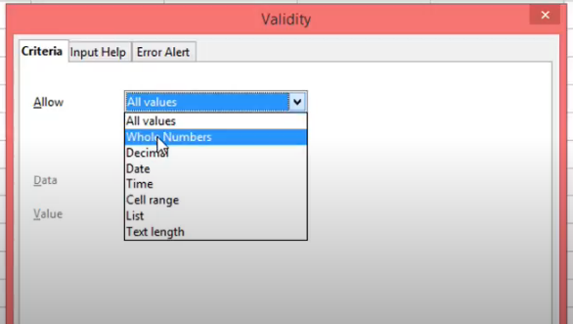
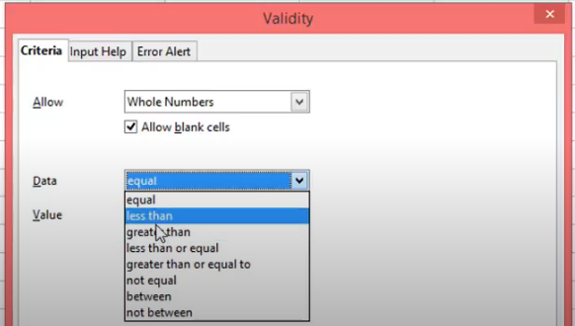
Data Validation
Suppose we want to restrict users to enter a whole number between 0 to 10.
Create Data Validation Rule
Select the cell where you want to apply validation
From the menu select Data -> Validity.
On the criteria tab, specify the allowable values using the operators available such as equals, greater than, less than, between etc.

Slide 25
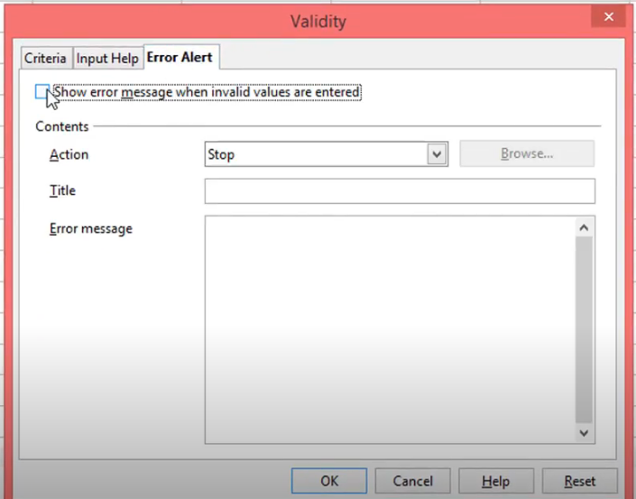
Data Validation
In the “Input help” tab, specify a message that you want to pop up when ever user selects a cell.
If users ignore the input message specified in “Input help” tab and enter a number that is not valid, you can show them an error alert using “Error alert” tab.

Slide 26
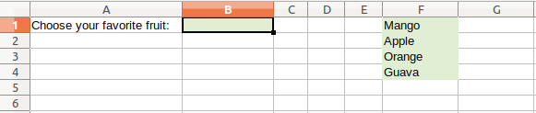
Data Validation Using DropDown List
While accepting data in a spreadsheet, it is possible to provide the user a choice of items in a form of a drop-down list. Users can select the desired value from the drop-down instead of custom text. This eliminates the possibility of error, duplicate in the data entry/collection process.
Example
Suppose we want users to select their favorite fruits in cell B1 from a list of fruits which is F1:F4.
Select cell B1 and from the menu select Data -> Validity.
In the Validity window, Criteria tab, select “Cell Range” against Allow field.
Check Show selection list and un-check allow empty cells.
In the source field, click the small Shrink button at the right and select the F1:F4 range.
Press Ok.

Slide 27
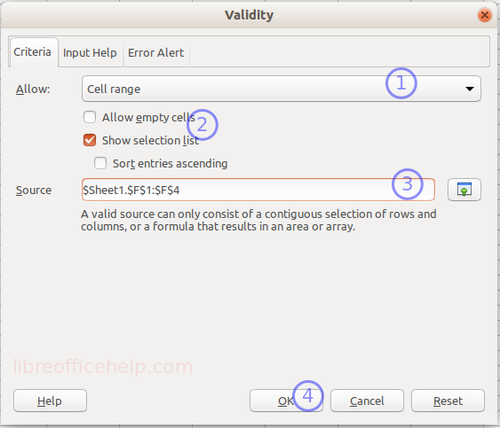
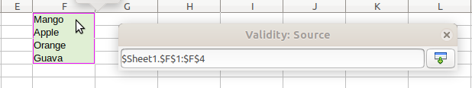
Data Validation Using DropDown List

Slide 28
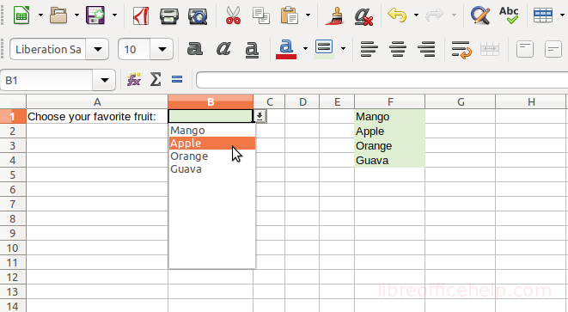
Data Validation Using DropDown List
In cell B1, you can see a small down-arrow button. Click the button and the drop-down would show the list of values from the source range.
Now, you can select a value from the drop-down list.
If the user wants to type a different value in cell B1, the data validation would give an error by default saying it is an invalid value.

Slide 29
What-if analysis

Slide 30
What-if analysis
Its an automated processes to quickly perform useful analysis of your data.
In addition to formulas and functions, Libre Calc includes several tools for processing your data. These tools include features for copying and reusing data, creating subtotals, running what-if analysis, and performing statistical analysis.
Usually, you create a formula to calculate a result based upon existing data. LibreOffice Calc includes tools to help you experiment and answer questions with your data, even when the data is incomplete. This is possible with a feature what-if analysis.

Slide 31
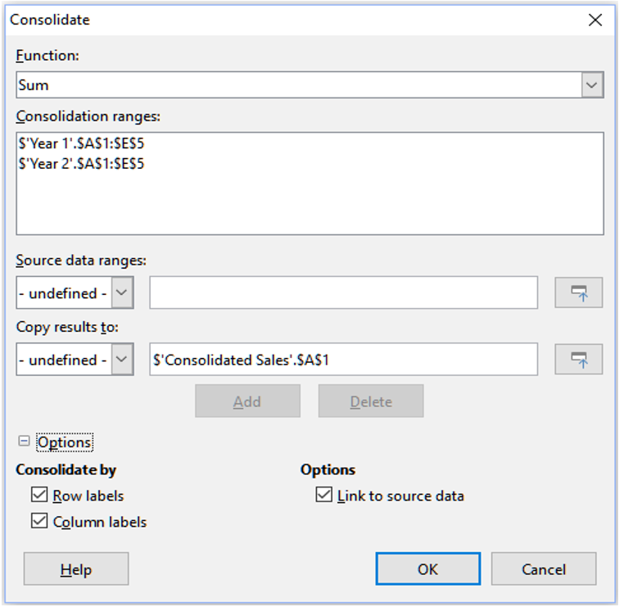
What-if analysis
Consolidating Data
The Consolidate tool allows you to combine and aggregate data spread across one or more sheets. This tool is useful if you need to quickly summarize a large, scattered set of data for review.
For example, you could use it to consolidate
multiple department budgets from different
sheets into a single company-wide budget
contained in a master sheet.
Open the range of cells you want to consolidate
then choose Data > Consolidate

Slide 32
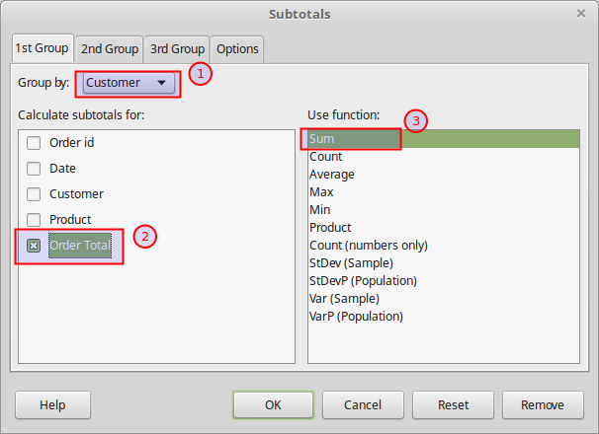
What-if analysis
Subtotals
The Subtotal command allows you to automatically create groups and use common functions like SUM, COUNT, and AVERAGE to help summarize your data. For example, you could use the Subtotal command to calculate the cost of office supplies by type from a large inventory order.
Select, or click in a single cell in the range of cells that you want to calculate subtotals for, and then choose Data > Subtotals

Slide 33
Scenarios
Scenarios are saved, named cell ranges that you can use to answer “what-if” questions about your data. You can create multiple scenarios for the same calculation set, then quickly swap between them to view the outcomes of each.
This feature is useful if you need to test the effects of different conditions on your calculations, but do not want to deal with repetitive manual data entry.
For example, if you wanted to test different interest rates for an investment, you could create scenarios for each rate, then switch between them to find out which rates work the best for you.
Choose Tools > Scenarios on the Menu bar to open the Create Scenario dialog

Slide 34
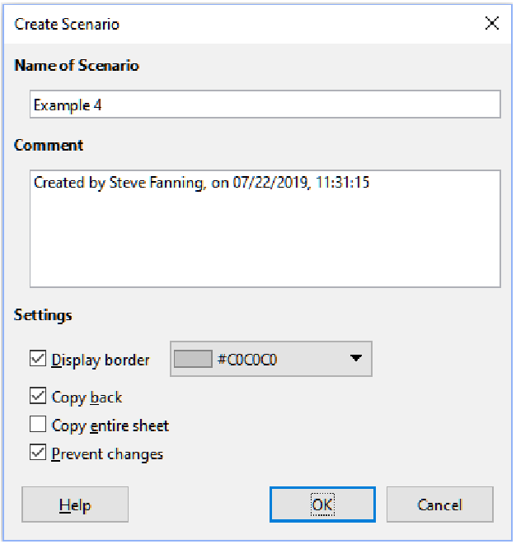
Scenarios

Slide 35
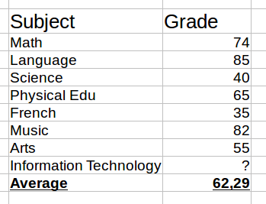
Goal Seek
Usually, you use a formula to calculate a result from existing values. In contrast, with Goal Seek, you work backwards from a result to discover what values produce it.
This feature is useful if you already know the outcome you want, but need to answer questions such as how to reach it or how it could be changed if you altered conditions.
Let's examine a simple example. A student tracks his final exam grades in school using a spreadsheet shown in the image below. So far he has received all grades for each subject except the one marked with a question mark. Currently the average grade is 62 but he needs at least a 65 to pass the class. What is the minimum score he must achieve in the Information Technology exam in order to pass the class? Instead of manually trying random values he can use Goal Seek to find out what grade he
needs on the final exam to pass.

Slide 36
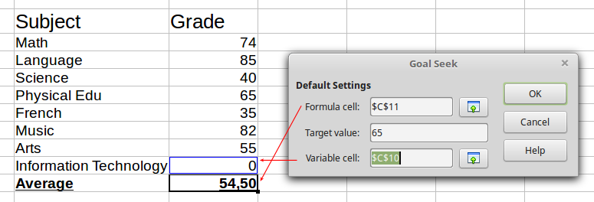
Goal Seek

